Slide 1
The neuroprotective effects of exercise on rotenone-treated rat model of Parkinson's disease

Slide 2
Organization of basal ganglia
The term basal ganglia applied to 5 interactive strucures on each side of the brain.
Caudate nucleus.
Putamen.
Globus pallidus.
Subthalamic nucleus.
Substantia nigra.

Slide 3
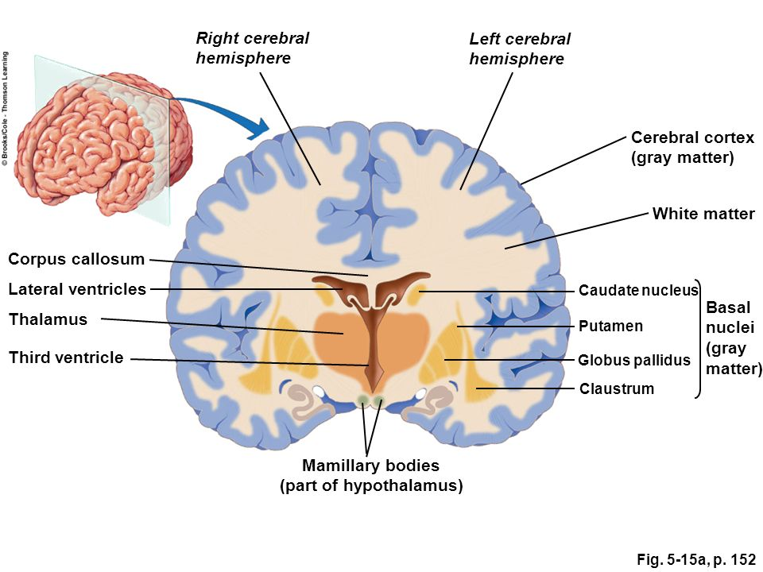
The Basal Ganglia

Slide 4
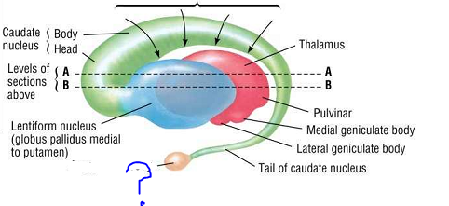

Slide 5
Organization of basal ganglia
Caudate nucleus + Putamen = stiatum.
Putamen + Globus pallidus = lenticular nucleus.
Globus pallidus is devided into internal &external segments(Gpi &Gpe)→GABAergic neurons.
Substantia nigra→ Pars Compacta (dopaminergic) &Pars Reticularis (GABAergic)

Slide 6
Organization of basal ganglia
At least there are 4 types of striatal neurons.
95% of striatal neurons →medium spiny neurons (GABA).
Aspiny neurons:
- Large : Acetylcholine.
- Medium: Somatostatin.
- small:GABA.

Slide 7
The Basal Ganglia connections (Input)
Input : 2 major inputs both are exitatory (glutamate) & both terminate on the stiatum, which are:
-corticostriate pathway.
- Thalamostriatal pathway: from intralaminar nuclei of the thalamus.

Slide 8
The Basal Ganglia connections (Output)
Output : 2 major output of both are inhibitory (GABA)& both project to the thalamus,
- SNPR
- Gpi
From the thalamus→ exitatory (may be glutamate) projections to prefrontal & premotor cortex.
This completes a full cortical-basal ganglia-thalamic-cortical loop(putamen circuit and caudate circuit).

Slide 9
The Basal Ganglia connections (Interconnections)
Nigrostriatal projection (dopaminergic) from SNPC to the striatum
GABAergic projection from striatum to SNPR.
Inhibitory projections from striatum to Gpi &GPe.
Gpe send →inhibitory projection to subthalamic nuclei in turn send → exitatory projections (Glutamate) to Gpe &Gpi.

Slide 10
Brain stem connections of basal ganglia
Fibers from Gpi →PPN (pedunculopontine nuclei, part of reticular formation) → brain stem and spinal cord.
Vestibular Nucleus, Red Nucleus & Inferior Olivary Nucleus receive projections fom GPi then to the spinal cord through extrapyramidal tracts.

Slide 11
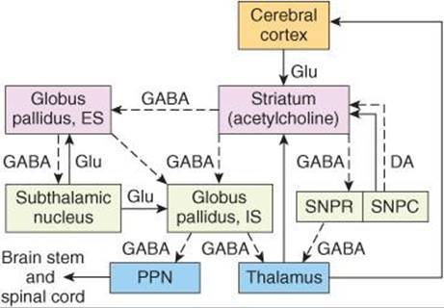
Basal Ganglia connections

Slide 12
Basal Ganglia Pathways
Direct pathway
Activated by binding of dopamine to D1 receptors in the striatum.
Direct inhibition of basal ganglia output to motor thalamus (inibitory output)
Disinhibition of motor thalamus →promote movement.
Lesion→difficulty intiating movement ( PD).

Slide 13
Basal Ganglia pathways
b) Indirect pathway
Inhibited by bining of dopamine to D2 receptors in the striatum.
Indiect stimulation of basal ganglia inhibitory output to motor thalamus → subthalamic nucleus.
Inhibition of motor thalamus → inhibition of movement.
Lesion→spontaneous movement (Huntington disease).

Slide 14
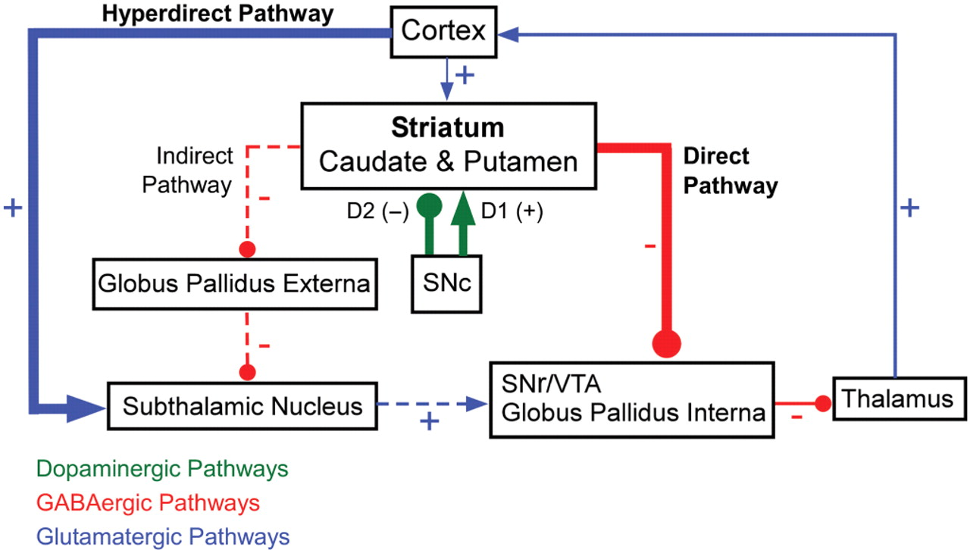
Basal Ganglia pathways

Slide 15
Basal Ganglia function
1- Planning and programming of movement.
2- Control of automatic associated movements.
3- Caudate nucleus play role in some cognitive processes.
Through its inter-connection with frontal portion of the neocortex.
Lesion in caudate N. disrupt test involving object reversal & delayed alternation
Lesions of left(not right) head of caudate N. → dysarthic form of aphasia resembles wernicke aphasia.
4- Control of muscle tone .
Lentiform N. → decrease MT →inhibit vestibular N.& stimulate the inhibitory reticular formation.
Caudate N.→ facilitate MT →stimulate facilitatory reticular formation ,vestibular &olivary N.
3

Slide 16
Basal Ganglia Diseases
3 distnict biochemical pathways operate in balance , lesion in one or more → abnormality
1- nigrostriatal dopaminergic system.
2- intrastriatal cholinergic system.
3- GABAergic system from the striatum ti SN & GP.
2 types of disorders , hyperkinetic (chorea, asthetosis & ballism) or hypokinetic (akinesia & bradykinesia..

Slide 17
Basal Ganglia diseases
Chorea.
Asthetosis.
Hemiballismus.
PD.
Wilson disease.
Kernicterus.
Tardive dyskinesia.

Slide 18
Parkinson disease(PD)
PD is a degenerative disease involving loss of dopaminergic neurons in the substantia nigra, which cause relative deficiency of dopamine and excess of acetyl ch. in the striatum.
It was originally described in 1817 by James Parkinson and is named for him. Parkinson disease is the first disease identified as being due to a deficiency in a specific neurotransmitter .In the 1960s, Parkinson disease was shown to result from the degeneration of dopaminergic neurons in the substantia nigra pars compacta. The fibers to the putamen (part of the striatum) are most severely affected.

Slide 19
There are 7–10 million people worldwide in whom Parkinson disease has been diagnosed.
The disease is 1.5 times more prevalent in men than women.
Parkinsonism occurs in sporadic idiopathic form in many middle-aged and elderly individuals and is one of the most common neurodegenerative diseases.
It is estimated to occur in 1–2% of individuals over age 65. Dopaminergic neurons and dopamine receptors are steadily lost with age in the basal ganglia in healthy individuals, and an acceleration of these losses apparently precipitates parkinsonism. Symptoms appear when 60–80% of the nigrostriatal dopaminergic neurons degenerate.

Slide 20
Etiology of PD
the loss of dopamine (DA) neurons in the substantia nigra (SN) is responsible for most of the characteristic motor dysfunctions, and there is reason to believe that the loss of DA contributes to other aspects of the disorder, as well.
Environmental toxins are major risk factors.
Mitochondrial dysfunction is central to the pathophysiology of PD. decreased mitochondrial complex I activity and increased activity of the 𝛼-ketoglutarate dehydrogenase complex in patients with PD.
Oxidative stress which can result from mitochondrial dysfunction, reduced antioxidant capacity, and reactive oxygen species that occur due to DA metabolism also plays a significant role in the etiology of the disease.
There is a significant inflammatory component of the disease.

Slide 21
Features of PD
PD has both hypokinetic and hyperkinetic features.
The hypokinetic features of Parkinson disease are akinesia and bradykinesia.
the hyperkinetic features are cogwheel rigidity and tremor at rest.

Slide 22
Manifestation of PD
Muscle rigidity
The rigidity is different from spasticity because motor neuron discharge increases to both the agonist and antagonist muscles. Passive motion of an extremity meets with a plastic, dead-feeling resistance that has been likened to bending a lead pipe and is therefore called lead pipe rigidity. Sometimes a series of “catches” takes place during passive motion (cogwheel rigidity), but the sudden loss of resistance seen in a spastic extremity is absent.

Slide 23
2- Akinesia or dyskinesia(lack of movement)and bradykinesia
Absence of motor activity and the difficulty in initiating voluntary movements.
There is a decrease in the normal unconscious movements such as swinging of the arms during walking.
lack of facial expressions (musk face).
Slow monotonus and low volume speech.
Shuffling gait.

Slide 24
3- Static Tremors
The tremor, which is present at rest and disappears with activity and durind sleep, is due to regular, alternating 8-Hz contractions of antagonistic muscles.
Marked in the upper limb, in the hand (pill-rolling movement).

Slide 25
Pathogenesis of PD
In healthy individuals, basal ganglia output is inhibitory via GABAergic nerve fibers.
The dopaminergic neurons that project from the substantia nigra to the putamen normally have two effects. They stimulate the D1 dopamine receptors, which inhibit GPi via direct GABAergic receptors; and they inhibit D2 receptors, which also inhibit the GPi.
the inhibition reduces the excitatory discharge from the subthalamic nucleus to the GPi.
This balance between inhibition and excitation somehow maintains normal motor function.

Slide 26
In PD, the dopaminergic input to the putamen is lost. This results in decreased inhibition and increased excitation from the subthalamic nucleus to the GPi. The overall increase in inhibitory output to the thalamus and brainstem disorganizes movement.
The genes for at least five proteins can be mutated. These proteins appear to be involved in ubiquitination. Two of the proteins, α-synuclein and barkin, interact and are found in Lewy bodies. The Lewy bodies are inclusion bodies in neurons that occur in all forms of Parkinson disease.

Slide 27
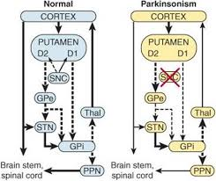

Slide 28
An important consideration in Parkinson disease is the balance between the excitatory discharge of cholinergic interneurons and the inhibitory dopaminergic input in the striatum. Some improvement is produced by decreasing the cholinergic influence with anticholinergic drugs. More dramatic improvement is produced by administration of L-dopa (levodopa).

Slide 29
Treatment of PD
There is no cure for Parkinson disease, and drug therapies are designed to treat the symptoms.
Improvement is produced by administration of L-dopa (levodopa). Unlike dopamine, this dopamine precursor crosses the blood-brain barrier and helps repair the dopamine deficiency. However, the degeneration of these neurons continues and in 5–7 years the beneficial effects of L-dopa disappear.
Sinemet, a combination of levodopa (L-dopa) and carbidopa, is the most commonly used drug for the treatment of Parkinson disease. The addition of carbidopa to L-dopa increases its effectiveness and prevents the conversion of L-dopa to dopamine in the periphery and thus reduces some of the adverse side effects of L-dopa (nausea, vomiting, and cardiac rhythm disturbances).

Slide 30
Dopamine agonists, including apomorphine, bromocriptine, pramipexole, and ropinirole, have also proven effective in some patients with Parkinson disease.
As combination with levodopa, cathechol-O-methyltransferase (COMT) inhibitors (eg, entacapone) are another class of drugs used to treat this disease. They act by blocking the breakdown of L-dopa, allowing more of it to reach the brain to increase the level of dopamine.
MAO-B inhibitors (eg, selegiline) also prevent the breakdown of dopamine. They can be given soon after diagnosis and delay the need for levodopa.

Slide 31
The US Food and Drug Administration has approved the use of deep brain stimulation (DBS) as a method for treating Parkinson disease. DBS reduces the amount of L-dopa patients need and thus reduce its adverse side effects (eg, involuntary movements called dyskinesia). DBS has been associated with reducing tremors, slowness of movements, and gait problems in some patients.

Slide 32
Surgical treatment of PD
Surgical treatments in general are reserved for those who have exhausted drug therapies or who have not responded favorably to them.
Lesions in GPi (pallidotomy) or in the subthalamic nucleus (thalamotomy) have been performed to help restore the output balance of the basal ganglia toward normal .
Another surgical approach is to implant dopamine-secreting tissue in or near the basal ganglia. Transplants of the patient’s own adrenal medullary tissue or carotid body works for a while, apparently by functioning as a sort of dopamine minipump, but long-term results have been disappointing. Results with transplantation of fetal striatal tissue have been better, and there is evidence that the transplanted cells not only survive but make appropriate connections in the host’s basal ganglia. However, some patients with transplants develop dyskinesias due to excessive levels of dopamine.

Slide 33
Animal models of PD
There are three current techniques for producing in vivo models of Parkinson’s disease:
1-Unilateral lesioning with 6-hydroxydopamine (rats)
2-Systemic injection of 1-methyl 4-phenyltetrahydropyridine (MPTP)(mice and monkeys).
3-Systemic injection of rotenone (rats).

Slide 34
6-OHDA RAT MODEL
This is the traditional model for testing Parkinson’s therapies, especially those intended to increase dopamine levels in the striatum.
The principal advantage of this model is that it is very sensitive to dopamine agonists.
The toxin 6-hydroxydopamine (6-OHDA) is injected on one side of the rat, while the opposite side serves as an intra-animal control.
This injection produces DA neuron loss on the injected side while sparing the contralateral DA neurons.

Slide 35
MPTP MOUSE MODEL
The MPTP mouse model of Parkinson’s disease is thought to mimic more closely the behavioral pathology of Parkinson’s disease, compared to the 6-OHDA rat model, and is currently the model of choice.
Mice exhibit Parkinson’s-like symptoms following systemic injection of the pyridine toxin MPTP, which produces a loss of striatal dopamine (DA) nerve terminal markers and, at higher doses, death of DA neurons in the substantia nigra.
Since the process of terminal loss and degeneration takes 6-9 days following MPTP injection, drugs can be administered both before the MPTP is given (to assay neuroprotection), and/or while the toxin is active in the first week post-injection (to assay preservation of dopamine function).

Slide 36
THE ROTENONE MODEL
The most recent of the Parkinson’s models uses systemic injection of rotenone, a member of a class of compounds found in pesticides, and in natural products, that disrupts mitochondrial activity and results in pathology that is strikingly
similar to that seen in Parkinson’s disease (e.g., accumulation and aggregation of α-synuclein and ubiquitin, progressive oxidative damage, and caspase dependent death).

Slide 37
Only recently have reliable behavior tests become available with this model. This reliability comes from using two distinct protocols, each with different optimal doses of the toxin.
In the first protocol, a lower dose is used that minimizes the loss of animals before the 3-week endpoint of a typical study, yet still produces a decrease in TH in the striatum. The extent of reduced TH activity is variable across rats and there is no correlation between the extent of TH loss and the behavioral deficits. Thus, this model is appropriate for testing compounds that reduce toxicity and the resultant behavioral deficits, but their effect on dopamine activity is secondary.

Slide 38
In the second protocol a higher dose of rotenone is used that produces pronounced neuropathology. In this case the endpoint measure is acute “toxic” behavior that requires perfusion of the animal.
These animals have a reliable loss of TH in the striatum and loss of DA neurons in the nigra, both of which can be measured.
A neuroprotective compound tested in this version of the model would decrease the number of rats displaying “toxic” behavior at a set post-lesion time point, or prolong the average time before “toxic” behavior. A positive control in this protocol is Coenzyme Q, which is neuroprotective.

Slide 39
MPTP PRIMATE MODEL
Similar to the MPTP mouse model, this model is most often used as a final study of a test compound’s efficacy before testing in humans.
The non-human primate species used are either cynomolgus, rhesus, or African green monkeys.
Following systemic MPTP administration, the animal’s motor and cognitive functions are impaired, as in humans. In particular the animals display muscle rigidity, akinesia, and tremors, along with impairment on a common memory task, delayed match to sample (DMTS).

Slide 40
IN VITRO MODELS
Rotenone
A botanical compound obtained from the roots of Derris sp., rotenone is an active ingredient in many pesticides. Rotenone blocks complex I of the mitochondrial respiratory chain and there by induces nigrostriatal degeneration in rodents, thus reproducing the hallmark pathology of Parkinson’s disease.
MPP+
The active metabolite of MPTP, MPP+ is a piperidine derivative which induces a Parkinsonian syndrome in mice and primates. MPP+ selectively enters dopamine neurons via the dopamine transporter and also blocks complex I of the mitochondrial respiratory chain.
Epoxymicin
Epoxymicin, a natural product isolated from Actinomyces sp., is a cell permeable, potent, selective and irreversible proteasome inhibitor. Impairment of the ubiquitin-proteasome system replicates features of Parkinson’s disease.

Slide 41
Exercise and PD
For many years, there has been the notion that an altered
environment can have an impact on neuronal structure and
function.
One of the earliest mentions of this idea was by the Italian
neuroanatomist Michele Vicenzo Malacarne, who reported in 1793
that dogs and birds that had undergone “training” had larger and
more complex cerebellar structures than unattended littermates. In
the early 1800s, Johann Spurzheim suggested that the brain was
capable of increasing in size due to exercise and proposed that this
idea be tested by a rigorous application of the scientific method.
The idea that the size of the brain could be altered in response to
changes in the environment, however, stayed within the purview of
phrenologists for over 100 years.

Slide 42
In 1947, Donald Hebb described superior maze performance of rats reared as domestic pets compared with their relatively impoverished laboratory-reared counterparts.
Then, in the 1960s,Krech, Bennett, and Rosenzweig, The team housed groups of rats in a large cage that provided many opportunities to explore the space and the objects it contained, some of which were frequently changed. They found that this led to increased social interaction, physical exercise, and opportunities to learn that were associated with changes in the structure, neurochemistry, and function of the rodent brain.

Slide 43
Physical exercise is currently applied as a behavioral intervention to improve motor symptoms in patients with PD (Lee et al., 2015). Exercise can improve and alleviate memory loss in elderly(Karmer et al., 2006),and decrease the risk of developing PD (Cotman and Berchtold,2002).the neuroprotective potentials of exercise is great, but the underlying mechanisms remain a debatable issue.

Slide 44
Putative Mechanisms Underlying the Relationship of Physical Activity and Cognitive Function
Four main hypotheses have been proposed to explain these mechanisms:
The cardiovascular.
Immunologic.
Neuroendocrine.
Neurotrophic signaling hypothesis.

Slide 45
Cardiovascular Effects
Adequate levels of physical activity are vital for improved small vessel condition (Schmidt et al., 2013), increased cerebral blood flow, and nutrient delivery (Swain et al., 2003).
Increased levels of physical activity were inversely correlated with reductions in gray and white matter loss, particularly in the prefrontal, superior parietal, and temporal cortices (Colcombe et al., 2003).

Slide 46
Rodent studies have demonstrated that running exercise lead to improvements in vascular perfusion and angiogenesis in the motor cortex, alterations that were restricted to the motor regions of the cerebral cortex. Other studies have suggested that motor skill training increases synaptogenesis in corresponding regions (Kleim et al., 1996)

Slide 47
aged individuals accrue cognitive deficits over time. physical activity is an important modulator of cognition across the lifespan, but that the contribution of cardiovascular fitness for sustaining healthy cognitive function increases with age by impacting central and peripheral cellular processes.

Slide 48
Immunological Effects
Physical activity results in increased levels of pro-inflammatory, anti-inflammatory cytokines, cytokine inhibitors and chemokines depending upon the intensity and duration of such exercise, with overall enhancement of immune function and anti-inflammatory processes.
Regular physical activity decrease viral and bacterial infections (DiPenta et al., 2004; Kohut and Senchina, 2004), a lower incidence of systemic lowgrade inflammation (Stewart, 2002; Colbert et al., 2004), and a lower incidence of neurodegeneration and cognitive decline (Cotman et al., 2007).

Slide 49
Kohut et al. (2006) studied older adults participating in aerobic or flexibility exercise for 10 months and found a significant reduction in plasma levels of interleukin 6 (IL-6), interleukin 8 (IL-8), C-reactive protein (CRP), and tumor necrosis factor (TNF), linking physical activity to antiinflammatory processes in the central nervous system (CNS).

Slide 50
TROPHIC FACTOR SIGNALING Neurotrophins
Improved trophic factor signaling has been considered as the most popular hypothesis to explain the positive effects of physical activity on cognition, with attention centering on the neurotrophins (NTs).
NTs are comprised of a closely related family of polypeptides that regulate a variety of neuronal functions including proliferation, survival, migration, and differentiation (Salehi et al., 2003, 2004).
The mammalian NTs include nerve growth factor (NGF), brain derived neurotrophic factor( BDNF), neurotrophin-3 (NT-3) and, neurotrophin- 4/5 (NT4/5).
These factors are synthesized by target neurons, initially in the form of pre-pro-protein.

Slide 51
The biological actions of NTs are mediated by binding to two different classes of receptor systems, the low affinity P75NTR receptor and the tropomyosin related kinase (Trk) family of high affinity tyrosine kinase receptors (Curtis et al., 1995; Villanueva, 2013). Following binding to their receptors, NTs are internalized along with their receptor and transported via retrograde axonal transport to the cell soma where they initiate multiple survival promoting effects within the nucleus.

Slide 52
Brain Derived Neurotrophic factor BDNF
Among NTs, BDNF is the most widely expressed in the brain, affecting neuronal survival, differentiation, axonal path-finding (Reichardt, 2006), regulation of dendritic trafficking to postsynaptic densities (Nakata and Nakamura, 2007), protection against neuronal death in the hippocampus (Pringle et al., 1996), and the induction and maintenance of late phase long-term potentiation (Korte et al., 1995)

Slide 53
Human gene expression studies have demonstrated that central BDNF synthesis is highest in the cortex and hippocampus, followed by the amygdala, basal forebrain, dorsal vagal complex, hindbrain, and ventral tegmental area of the midbrain.
BDNF is synthesized in the periphery by vascular endothelial cells, T-cells, B cells, monocytes (Kerschensteiner et al., 1999; Nakahashi et al., 2000) and skeletal muscles (Mousavi and Jasmin, 2006). Once released, BDNF can cross the BBB bi-directionally (Pan et al., 1998), resulting in a direct relationship between BDNF levels in plasma and the brain (Karege et al., 2002).

Slide 54
BDNF, physical activity, and cognition
Studies have demonstrated the intensity of exercise training is positively correlated with BDNF plasma levels in young, healthy individuals (Ferris et al., 2007).
it appears that BDNF increase originates from both central and peripheral sources, with 70–80% of circulating BDNF derived from the brain and the remaining levels derived from peripheral sources.
rodent studies showing that endurance training leads to increased synthesis of BDNF in the hippocampal formation (Neeper et al., 1995, 1996). Similarly, a significant positive correlation exists for levels of physical activity and BDNF mRNA expression in the hippocampus in rats. Exercise induced upregulation of BDNF has been noted in the perirhinal cortex

Slide 55
Insulin-like growth factor
Insulin-like growth factor 1 (IGF-1) is an important trophic factor for growth and metabolic reactions.
The main sources of IGF-1 production include muscles, liver, and the brain.
Cells with an important role in IGF-1 production in the brain include perivascular macrophages, microglia and endothelial cells of the blood vessels and vascular smooth muscle cells.
Intracerebroventricular injection of IGF-1 in old rats was able to restore object recognition in these rats (Markowska et al., 1998).
IGF-1 levels are low at birth and increase to the age of 20 years, thereafter declining gradually.
Peripheral administration of IGF-1 can increase the number of newborn neurons.

Slide 56
Peroxisome proliferator-activated receptor-gamma coactivator protein-1α (PGC-1α)
Peroxisome proliferator-activated receptor-gamma coactivator protein-1alpha (PGC-1α) is a transcriptional co-activator of mitochondrial biogenesis and oxidative metabolism in brown fat.
Pgc-1α mRNA has been shown to be highly expressed in the heart, skeletal muscle, and kidney, and to a lesser degree in the liver, pancreas, and brain
Pgc-1α null mice develop spongiform neurodegeneration in the striatum and deep layers of the cortex (Ma et al., 2010), and this phenotype has been implicated in PD and Huntington disease, strongly suggesting that PGC-1α plays a significant role in maintaining neuronal function.

Slide 57
Fibronectin type III domain containing 5(FDNC5)
It is a PGC- 1α-dependent myokine that is released during exercise.
Cleavage of FNDC5 by a proteolytic enzyme generates a 12 kDa peptide called irisin.
Following release, irisin activates oxygen consumption and thermogenesis in fat cells.
In rodents’ brain, Fndc5 mRNA has been found primarily in the midbrain, pons, cerebellum, and olfactory bulb. Additionally, very low amounts of Fndc5 mRNA can be found in the hippocampus. In the periphery, irisin immunoreactivity has been found in skeletal muscles (all types of muscle fibers) and cardiomyocytes.

Slide 58
Recently, it was shown that exercise induces Fndc5 gene expression in muscles, and in turn, increases levels of irisin in the circulation. Similarly, exercise leads to increased levels of both FNDC5 and irisin in circulation (Huh et al., 2012; Lecker et al., 2012). Accordingly, it has been shown that endurance exercise leads to increase expression of Fndc5 in the hippocampus (Wrann et al., 2013).

Slide 59
Neuroendocrine theory
The release of cortisol from the adrenal gland is regulated by the release of ACTH from the pituitary gland. Under physiological conditions, cortisol, in conjunction with epinephrine and norepinephrine, prepares an individual for the “fight or flight response”, enabling rapid shifting of blood flow toward large skeletal muscles and permitting an individual to flee threatening situations. Cortisol also plays a significant role in memory processes with areas of the brain important for memory (e.g., hippocampus, prefrontal cortex, amygdala) expressing high levels of GC receptors
Moderate intensity exercise → benefits to memory, exterme exercise with excessive cortisol levels →-ve effects on cognition.

Slide 60
NRF2
During evolution, cells have developed inducible defense systems against harmful endogenous and exogenous substances. Several transcription factors are involved in boosting the cell’s defenses. The major regulator of the so-called phase II and some phase III genes is the nuclear factor erythroid 2 related factor 2 (NRF2) .
The principle of theNRF2 system is to keep NRF2 protein low under normal conditions with the possibility of rapid induction in case of a sudden increase in oxidation status in the cell.
This is achieved by constitutive synthesis and degradation of NRF2 with the possibility of rapid redirection of NRF2 to the nucleus

Slide 61
NRf2- ARE signaling Pathway
NRF2 is a member of the cap’n’collar (CNC) family of transcription factors, which also include NRF1, NRF3 and p45 NF-E2.
NRF2 is a basic leucine zipper (bZIP) protein that in the nucleus heterodimerizes with small MAF or JUN proteins followed by binding to specific DNA sites termed anti-oxidant response elements (ARE) or electrophile response elements (EpRE)
.NRF2-ARE binding can initiate transcription of hundreds of cytoprotective genes including enzymes in the glutathione defense system and proteasome subunits. New findings connect NRF2 not only to an elevated anti-oxidant capacity but also to expression of other types of protective proteins such as brain derived neurotrophic factor , the anti-apoptotic B-cell lymphoma , the anti-inflammatory interleukin (IL)-10, the mitochondrial transcription (co)-factors NRF-1 and PGC-1α.
In the unstressed cell NRF2 is bound to Kelch-like ECH associated protein 1 (KEAP1) in the cytoplasm via its KEAP1 binding domain.

Slide 62
The NRF2 system and CNS disease
The NRF2 system is widely expressed in the CNS and is regulated in response to both acute cerebral insults and in neurodegenerative disease.
In addition to its crucial regulatory role in the endogenous defense to various cellular stresses, NRF2 is recognized as an important regulator of inflammation in the brain.
If suppression of NRF2 activity occurs in human brains the implications are elevated vulnerability to acute insults that involve oxidative stress, prolonged and more severe inflammation and likely an elevated risk to develop chronic diseases such as Parkinson’s disease (PD), Alzheimer’s disease (AD) and amyotrophic lateral sclerosis (ALS).

Slide 63
NFR2 & exercise
Acute exercise activates primary messengers such as adenosine monophosphate (AMP), calcium, and mechanical stress and subsequent secondary messengers including AMP-activated protein kinase (AMPK), calcium/calmodulin-dependent protein kinase (CAMK), and p38 mitogen-activated protein kinases, leading to acute changes in mRNA transcription.
Another important primary messenger that is stimulated by acute exercise is the temporary change in redox balance (or redox potential) towards a more oxidized state through production of reactive oxygen species (ROS).
While ROS were initially designated as damaging, there is now a greater understanding of the important role of ROS in cell signaling, regulation of immune function, gene transcription, and apoptosis . A prime example is the role of ROS in activation of the Nrf2, the master regulator of antioxidant enzymes and cellular stress resistance.

Slide 64
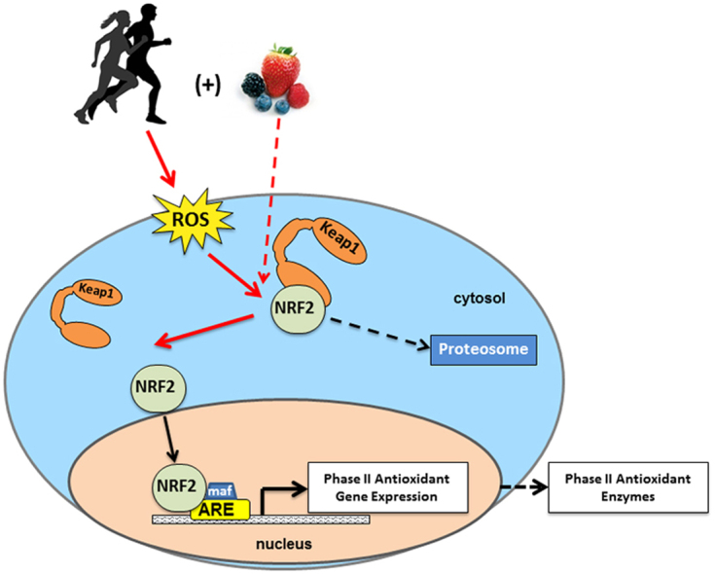
Effects of exercise on NFR2 pathway

Slide 65
The neuroprotective effects of exercise on rotenone-treated rat model of Parkinson's disease
The aim of the work
- To evaluate the rotenone as a model of PD in albino rats.
- To evaluate the role of treadmill exercise in albino rats ,in neuroprotection against rotenone induced PD.
- To evaluate the role of NRF2-ARE pathway in the potential neuroprotective effects.

Slide 66
Animals
80 adult male rats(8-10weeks), weight (200±10g) ,from Sohag faculty of science. the experiment will be held at physiology department, Sohag faculty of medicine. the rats will be housed in collective cages, with controlled environment at 12:12h dark-light cycle, at 25 C and 50% humidity, animals will be allowed to standard chow diet ad libitum. The study will be approved by Research Ethics Committee considering care and use of laboratory animals.

Slide 67
Methods
Ninety rats will be divided randomly into 6 groups (n=15 in each group):
Group I
15 rats used as a control group. Rat in this group will receive 1 ml/ kg vehicle i.p. once a day for 14 consecutive days.
Group II
15 rats used as exercise control group. Rats will receive1 ml/ kg vehicle i.p. once a day for 14 consecutive days. Rats in this group will exercise on a treadmill after the last drug injection for 30 minute/day 5 times/week for 4 weeks.
Group III
14rats used as rotenone- treated group. Rats in this group will receive 3mg/ kg rotenone in 1ml\kg vehicle i.p. once day for 14 consecutive days and stay sedentary for 4 weeks.
Group IV
15 rats used as rotenone- exercise group. Rats in this group will receive 3mg/ kg rotenone in 1ml\kg vehicle i.p. once day for 14 consecutive days. Rats in this group will exercise on a treadmill after the last drug injection for 30 minute/day 5 times/week for 4 weeks.
Group V
15rats in this group will receive 3mg/ kg rotenone in 1ml\kg vehicle i.p. once day for 14 consecutive days, 10 mg ⁄ kg L-dopa i.p daily and stay sedentary for 4 weeks.
Group VI
15rats in this group will receive 3mg/ kg rotenone in 1ml\kg vehicle i.p. once day for 14 consecutive days, 10 mg ⁄ kg L-dopa i.p daily. Rats in this group will exercise on a treadmill after the last drug injection for 30 minute/day 5 times/week for 4 weeks.

Slide 68
Exercise protocol
After the last drug injection, mice in exercise groups, will be allowed to treadmill exercise for 30 min/day, at a speed of up to 12 m/min , 5 times/weeks for 4 weeks (Shin et al., 2016) .
To evaluate the efficacy of exercise: NADH dehydrogenase activity in quadriceps femoralis muscle and whole brain will be measured by rate of NADH-dependent ferricyanide reduction at 420 nm (1 mM-1 9 cm-1).

Slide 69
Assessment of rotenone rat model of PD
Behavioral tests:
Tests will be performed before and after rotenone treatment.
Measurement of tyrosine hydroxylase in the striatum:
spectrophotemetric method or IHC

Slide 70
Open-field test
The test provides a unique opportunity to systematically assess novel environment exploration, general locomotor activity, and provide an initial screen for anxiety-related behavior in rodents.
Open Field is a circular or square chamber.The floor is divided up into quarters with a central circle or square in the middle of the arena. Normal laboratory up lighting is required. Video camera recording is started, Then the rat is gently placed in the centre of the open field. Each trial lasts for 10 minutes. At the end of each trial, the arena will be thoroughly cleaned with 70% alcohol solution, and dried with paper toweling. To assess spontaneous locomotion we measure : the distance moved, time spent moving, rearing,grooming, defecation, change in activity over time for each animal and time spent in the center and periphery of the field.
Open field exploration results are generally analyzed using repeated-measures analysis of variance (ANOVA)

Slide 71
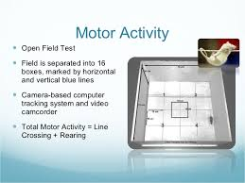
Open-field test

Slide 72
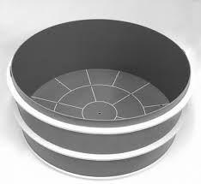
Open-field test

Slide 73
Object recognition test (ORT)
Object recognition test (ORT). In this test ORT rats are placed in an arena(similar to OFT) in order to evaluate the preference for a novel object, to assay the short-term memory (STM) and long-term memory (LTM).
Four objects used: A1, A2, B andC. The ‘‘A’’ objects are two identical triangles, the ‘‘B’’object was a ball and the ‘‘C’’ object was a rectangle. All objects were made of plastic material, with 10 cm 10 cm (length height). Each object had the pattern of color, as follows: blue, red and yellow.
Twenty-four hours after habituation, training was conducted by placing each individual rat for 5 min into the field, in which two identical objects (objects A1 and A2) were positioned in two adjacent corners, 10 cm fromthe walls.
In a STM test given 1.5 h after training, the rats explored the open field for 5 min in the presence of one familiar (A) and one novel (B) object. All objects presented similar textures, colors, and sizes, but distinctive shapes.

Slide 74
Between trials the objects washed with 10% ethanol solution.
LTM test given 24 h after training, the same rat explore the field for 5 min in the presence of a familiar object A and a novel object C.
Exploration defined as sniffing or touching the object with the nose and/or forepaws.
Data are expressed as the mean±SE percentage time exploring any of the objects (training) or the novel objects.
Exploratory preference in: Training =(A2 /(A1+A2)) 100; STM=(B / (A1+B)) 100; LTM=(C / (A1+C)) 100.

Slide 75
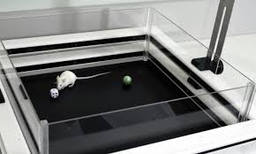
Object recognition test (ORT)

Slide 76
Foot print test
for assessing gait and locomotor activity. The fore and hind paws are painted with non-toxic dyes of different colors. The mice are then allowed to walk along a runway into an enclosed box, leaving their footprints on paper

Slide 77
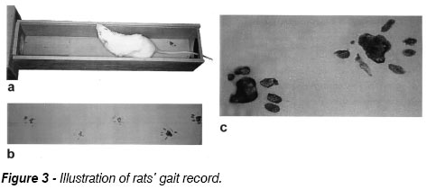
Foot print test

Slide 78
Rotarod test
To assess the motor coordination of the animals, we will used an accelerating Rotarod . The Rotarod consisted of a suspended rod, accelerating for 60 s from 5 rounds per minute (RPM) to 15 RPM and continuing at that speed for a further 60 s. A trial was stopped when the rat fell off the Rotarod or after the complete 120 s. The mean of three trials was taken. Prior to the chronic injections, the rats were trained for five days to perform the test and a baseline was established.

Slide 79
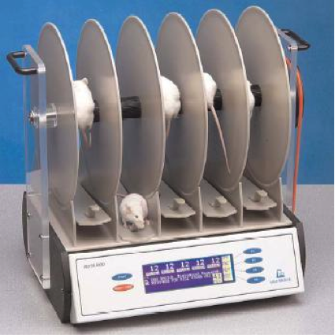
Rotarod test

Slide 80
Forced swim test (FST)
In order to measure depression, rats will be placed individually in water, in the FST cylinder (12 cm in diameter, filled with 25 cm water depth). Water temperature was adjusted within thermoneutral range (at 31 ± 1 °C) of rodents. The duration of immobility within a 6-min session was recorded as immobility score. The first 2 min of the test were omitted from calculations.

Slide 81
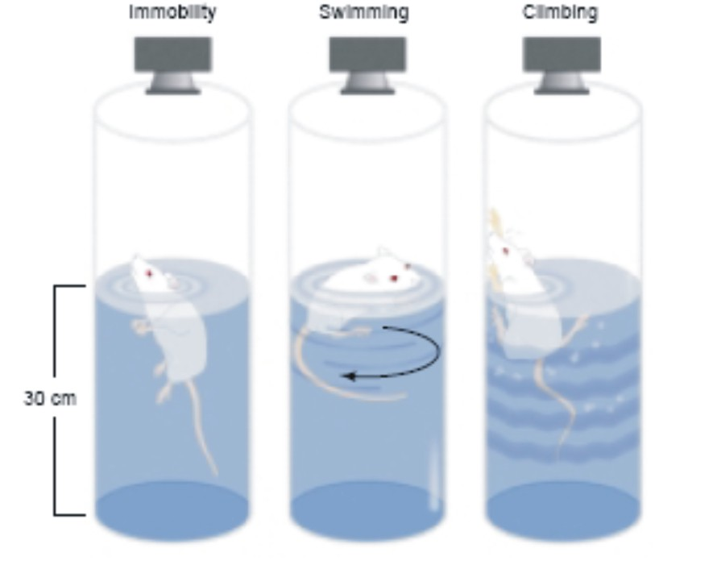
Forced swim test (FST

Slide 82
Quantitative Reverse Transcription-PCR (RT-qPCR)
Total RNA will be prepared from dissected, snap-frozen striatum and cDNA will be generated by reverse transcription. Primers for Nrf2, NDUFA6, TFAM and housekeeping β-actin to perform Real-time PCR.
To evaluate the possiple role of NFR2-ARE signaling pathway as possible mechanism for exercise induced effects in rotenone PD rats, brain.

Slide 83
Thank you
With all my respect

